Slide 1
Using GANs to create art
Rakhat Abdrakhmanov, Olzhas Zhangeldinov, Adil Zhiyenbayev, Aida Eduard

Slide 2
Introduction to the problem and project
Intro: Many people admire the style of Claude Monet, who uses certain colors, shapes and brush strokes, and creativity in his paintings. It is hard to replicate the style manually, but the power of Generative Adversarial Networks are able to cope with it, using style transfer.
Challenge: Capture the very essence of artistic ingenuity, not just replicating colors and shapes.
Goal:
Convert images to Claude Monet style artwork;
Generate a significant volume of Monet-style images, ranging from 7,000 to 10,000;
Make assessment (quality improvement) based on FID (Fréchet Inception Distance);
Test state-of-the-art GAN models on the dataset;
Improve results in Monet-style image generation.

Slide 3
Lit. | Method | Dataset | Accuracy | Task | Eval.
[1] | cGAN | Google Maps Cityscapes | Color: ATM:27.8% Aerial ATM: 6.1%,18.9% Labels↔Photo FCN: 0.66 | Map↔Aerial photo BW→color photos Sketch→photo Semantic Labels↔Photo | Amazon Mechanical Turk (AMT) FCN
[2] | CycleGAN | Google Maps Cityscapes | Aerial: ATM: 23%,27% Labels↔Photo FCN: 0.52,0.58 Content: 5.2% Style: 97.2% | Labels↔Photo Map↔Aerial photo | ATM FCN
[3] | DualGAN | Photo-sketch, Day-night, label-facades, and aerial maps | Aerial: ATM: 0.42 Content: 57.5% Style: 46.5% | Map↔Aerial photo | ATM Realness score
[4] | GANILLA | 9500 illustrations from 24 different artists | Content: 20% Style: 84.5% | Style-transfer Photo-Style image | CNN:classify style (artists) and content (scenery)

Slide 4
Metrics and data augmentation
FID - Fréchet Inception Distance (the similarity between two probability distributions in a metric space)
Process:
Feature Extractor: Inception-v3 Classifier
Remove the output layer of the Inception-v3 classifier, retaining the intermediate layer outputs.
Feed real and fake images through the modified Inception-v3 to obtain embeddings for each image.
Treat the obtained embeddings as two multivariate normal distributions.
Compute the Multivariate Normal Fréchet Distance between the two distributions.
Goal: To assess the feature distance between embeddings of real and fake images using statistical measures, providing a quantitative measure of the dissimilarity or similarity between the two distributions.

Slide 5
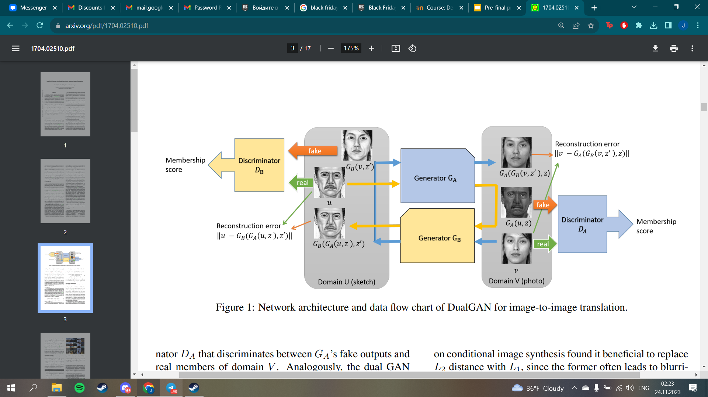
DualGAN [1]
Our baseline model is DualGAN, which can be considered as a simpler CycleGAN model;
  Two GANs: one maps U to V and the other one maps V to U;
  Both Generators consist of downsampling layers and upsampling layers;
  Baseline:
    FID = 190 after 200 epochs; FID = 140 after 1000 epochs (about 24 hours of training)

Slide 6
DualGAN first modification
As mentioned before DualGAN consists of two GANs, both have identical Generator and Discriminator architectures:
  We adjusted the architecture in a way that it would have more complex architecture;
  More downsampling and upsampling layers for both Photo generator and Monet generator;
  Resultant FID = 130 after 25 epochs (about 2 hours of training).

Slide 7
DualGAN second modification
9 Residual Blocks

Slide 8
DualGAN second modification continued
Motivated by the structure of CycleGAN, we added residual blocks in between without adding additional downsampling and upsampling layers;
The model was trained for 400 epochs (about 12 hours);
The resultant FID = 400.
9 Residual Blocks

Slide 9
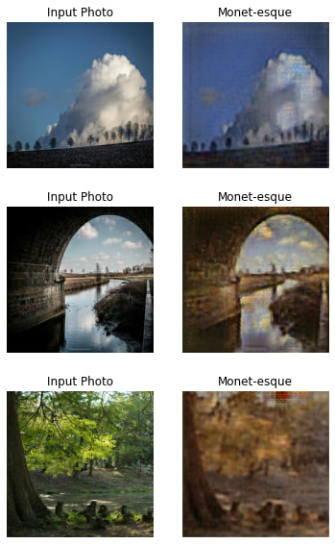
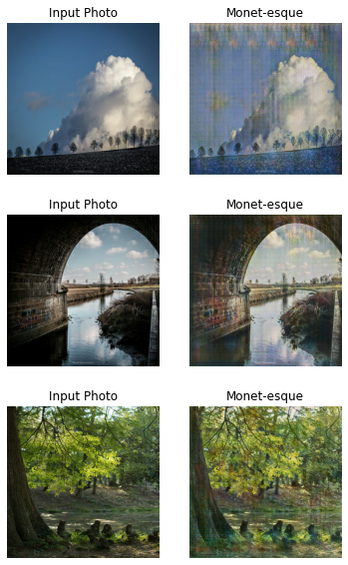
DualGAN qualitative results
DualGAN with improved architecture
DualGAN with residual blocks

Slide 10
DualGAN shortcomings
Improved architecture showed its effectiveness achieving the best DualGAN results after only 25 epochs;
Adding residual blocks to generators also showed improvement: same FID = 140 after 400 epochs (the baseline after 1000 epochs);
We possibly can integrate two approaches:
  We could not implement this because of the lack of the computational power;
  Implementing this might achieve the best DualGAN implementation among others;
  Still, the results are decent.

Slide 11
CycleGAN [2]
The architecture of the CycleGAN is similar to DualGAN
Optional identity loss = (U -> V) - V
Resultant FID = 124 (after 20 epochs == about 10 hours of training and without Identity loss); FID = 110 with Identity loss (after 20 epochs == 10 hours)
Residual Blocks

Slide 12
CycleGAN modification
We replaced Residual blocks with Inception blocks and tuned the parameters;
Training takes faster (20 epochs == 8 hours);
Resultant FID = 109
Inception Blocks

Slide 13
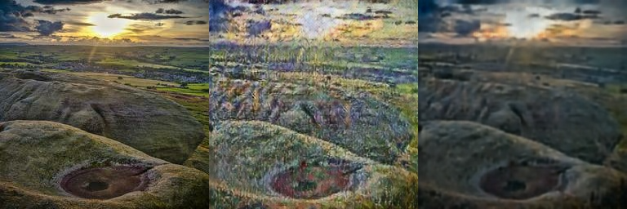
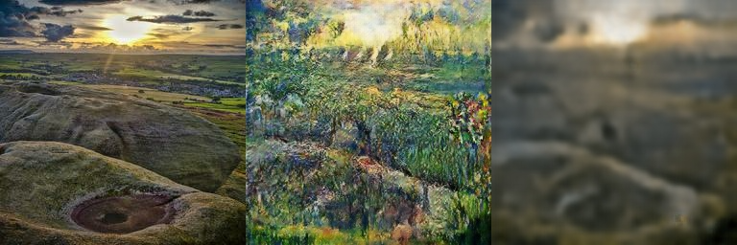
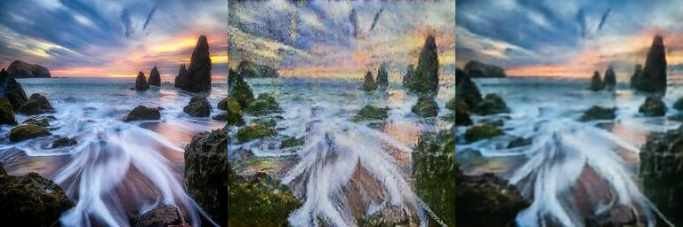
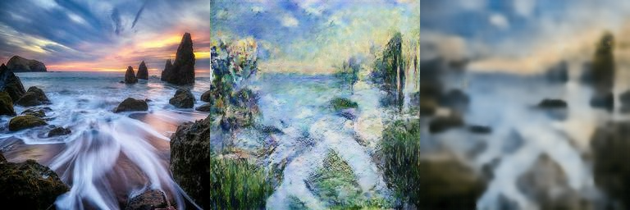
CycleGAN qualitative results
CycleGAN with ResNET
CycleGAN with Inception

Slide 14
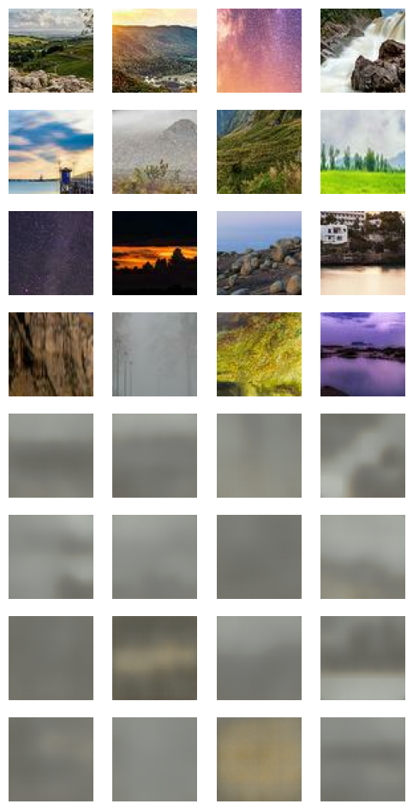
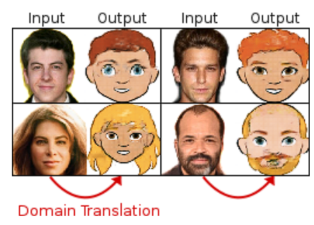
XGAN [4]
Semantic style transfer - transferring semantic style between 2 different domains
Authors claim XGAN works good on images from different domains
Similar pixel-level structure transfer is worse than other models
XGAN - main idea
XGAN, 400 epochs

Slide 15
Comparisons
 | DualGAN (1000 epochs) | DualGAN more complex (25 epochs) | DualGAN with ResNet (400 epochs) | CycleGAN | CycleGAN with inception
FID | 140 | 130 | 140 | 110 | 109

Slide 16
Conclusion
Some of the results are promising, and some are not much;
GANs require a lot of computational resources, which we lack;
The results that we have might transfer into much more better ones with the proper resources;
Some other problems:
  We do not have other works to compare (each work is very different);
  MiFID that we originally planned to implement requires old framework packages that we could not install.

Slide 17
Bibliography
[1] Z. Yi, H. Zhang, P. Tan and M. Gong, "DualGAN: Unsupervised Dual Learning for Image-to-Image Translation," 2017 IEEE International Conference on Computer Vision (ICCV), Venice, Italy, 2017, pp. 2868-2876, doi: 10.1109/ICCV.2017.310.
[2] J. -Y. Zhu, T. Park, P. Isola and A. A. Efros, "Unpaired Image-to-Image Translation Using Cycle-Consistent Adversarial Networks," 2017 IEEE International Conference on Computer Vision (ICCV), Venice, Italy, 2017, pp. 2242-2251, doi: 10.1109/ICCV.2017.244.
[3] Samet Hicsonmez, Nermin Samet, Emre Akbas, and Pinar Duygulu, “GANILLA: Generative adversarial networks for image to illustration translation”, Image Vision Comput, 95, C (Mar 2020), doi : 10.1016/j.imavis.2020.103886
[4]Royer, A. et al., “XGAN: Unsupervised Image-to-Image Translation for Many-to-Many Mappings”, In: Singh, R., Vatsa, M., Patel, V., Ratha, N. (eds) Domain Adaptation for Visual Understanding. Springer, Cham. doi: 10.1007/978-3-030-30671-7_3

